Slide 1
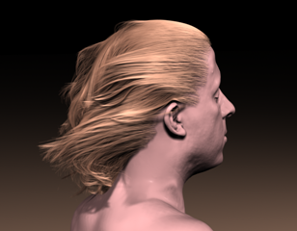
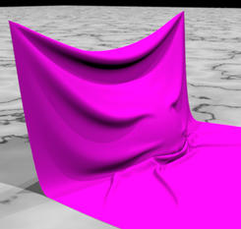
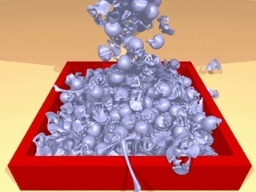
Chapter 5-1 Physically Based Simulation
Overview

Slide 2
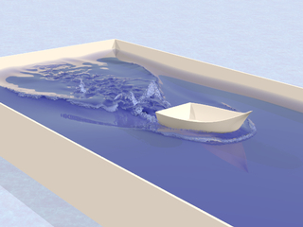
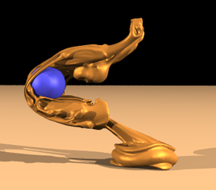
Content
Overview
Cloth Simulation
Particle System
Fluid Simulation
Hair Modeling & Simulation
Summary

Slide 3
1.1 Physical simulations
Model nature by using the laws of physics
Often, the only way to achieve realism
Alternative: try various non-scientific tricks to achieve realistic effects
Math becomes too complicated very quickly
Isn’t it incredible that nature can compute everything (you, me, and the whole universe) on the fly, it is the fastest computer ever.
Important issues: simulation accuracy and stability

Slide 4
1.2 Newton’s Laws
Newton’s 2nd law:
Tells you how to compute acceleration, given the force and mass
Newton’s 3rd law: If object A exerts a force F on object B, then object B is at the same time exerting force -F on A.

Slide 5
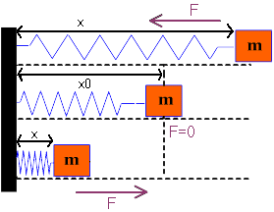
1.3 Single spring
Obeys the Hook’s law:
F = k (x - x₀)
x₀ = rest length
k = spring elasticity (aka stiffness)
For x<x₀, spring wants to extend
For x>x₀, spring wants to contract

Slide 6
1.3.1 Hook’s law in 3D
Assume A and B two mass points connected with a spring.
Let L be the vector pointing from B to A
Let R be the spring rest length
Then, the elastic force exerted on A is:

Slide 7
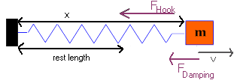
1.3.2 Damping
Springs are not completely elastic
They absorb some of the energy and tend to decrease the velocity of the mass points attached to them
Damping force depends on the velocity:
k_{d} ：damping coefficient
k_{d} different than k_{Hook} !！

Slide 8
Damping in 3D
Assume A and B two mass points connected with a spring.
Let L be the vector pointing from B to A
Then, the damping force exerted on A is:
Here v_{A} and v_{B} are velocities of points A and B
Damping force always OPPOSES the motion

Slide 9
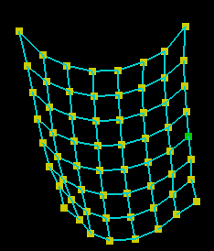
1.4 A network of springs
Every mass point connected to some other points by springs
Springs exert forces on mass points
Hook’s force
Damping force
Other forces
External force field
Gravity
Electrical or magnetic force field
Collision force

Slide 10
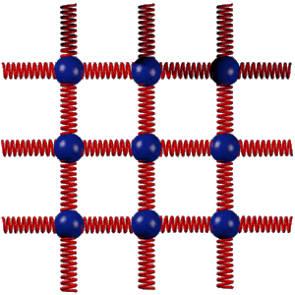
1.5 Mass-Spring System
Several mass points
Connected to each other by springs
Springs expand and stretch, exerting force on the mass points
Very often used to simulate cloth

Slide 11
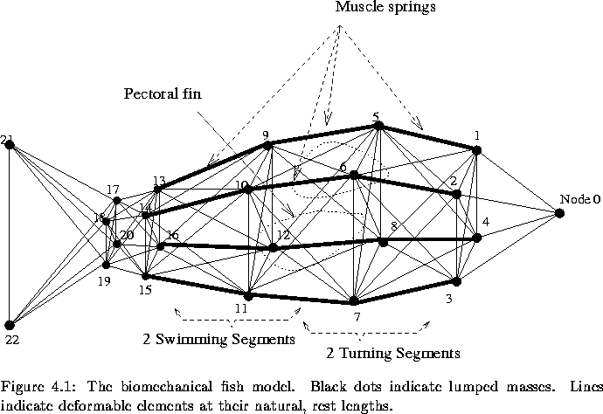
1.5.1 Mass Spring Fish
Model objects as systems of springs and masses
The springs exert forces, and you control them by changing their rest length
A reasonable, but simple, physical model for muscles

Slide 12
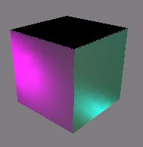
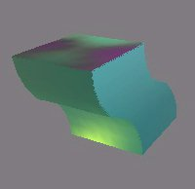
1.5.2 The jello cube
Undeformed cube
Deformed cube
The jello cube is elastic,
Can be bent, stretched, squeezed, …,
Without external forces, it eventually restores to the original shape.
Notes:
Jello:n. 凝胶物

Slide 13



1.6 How to organize the network
for jello cube
To obtain stability, must organize the network of springs in some clever way
Jello cube is a 8×8×8 mass point network
512 discrete points
Must somehow connect them with springs
Basic network
Stable network
Network out of control

Slide 14
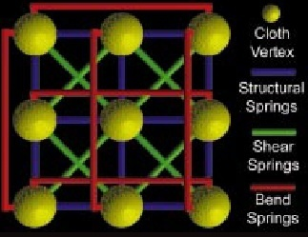
Solution:Structural, Shear and Bend Springs
There will be three types of springs:
Structural
Shear
Bend
Each has its own function

Slide 15
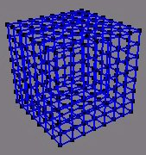
(1) Structural springs
Connect every node to its 6 direct neighbours
Node (i,j,k) connected to
(i+1,j,k), (i-1,j,k), (i,j-1,k), (i,j+1,k), (i,j,k-1), (i,j,k+1) (for surface nodes, some of these neighbors might not exists)
Structural springs establish the basic structure of the jello cube
Only springs connecting two surface vertices are shown.

Slide 16
(2) (2) Shear springs
Disallow excessive shearing
Prevent the cube from distorting
Every node (i,j,k) connected to its diagonal neighbors
A 3D cube (if you can’t see it immediately, keep trying)
Shear spring resists stretching and thus prevents shearing

Slide 17
(3) Bend springs
Prevent the cube from folding over
Every node connected to its second neighbor in every direction (6 connections per node, unless surface node)
Bend spring resists contracting and thus prevents bending

Slide 18
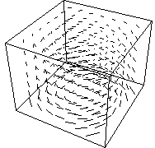
1.7 External force field
If there is an external force field, add that force to the sum of all the forces on a mass point
There is one such equation for every mass point and for every moment in time

Slide 19
1.8 Collision detection
The movement of the jello cube is limited to a bounding box
Collision detection easy:
Check all the vertices if any of them is outside the box
Inclined plane:
Equation: Initially, all points on the same side of the plane
F(x,y,z)>0 on one side of the plane and F(x,y,z)<0 on the other
Can check all the vertices for this condition

Slide 20
1.9 Collision response
When collision happens, must perform some action to prevent the object penetrating even deeper
Object should bounce away from the colliding object
Some energy is usually lost during the collision
Several ways to handle collision response
We will use the penalty method

Slide 21
(1) The penalty method
When collision happens, put an artificial collision spring at the point of collision, which will push the object backwards and away from the colliding object
Collision springs have elasticity and damping, just like ordinary springs
Boundary of colliding object
v
F
Collision spring

Slide 22
(2) Integrators
The equations of motion:
x = point position, v = point velocity, a = point acceleration
They describe the movement of any single mass point
F_{hook}=sum of all Hook forces on a mass point
F_{damping} = sum of all damping forces on a mass point

Slide 23
(2) Integrators
When we put these equations together for all the mass points, we obtain a system of ordinary differential equations.
In general, impossible to solve analytically
Must solve numerically
Methods to solve such systems numerically are called integrators
Most widely used:
Euler
Runge-Kutta 2nd order (RK2)
Runge-Kutta 4th order (RK4)

Slide 24
(3) Integrator design issues
Numerical stability
If time step too big, method “explodes”
t = 0.001 is a good starting choice
Euler much more unstable than RK2 or RK4
Requires smaller time-step, but is simple and fast
Euler rarely used in practice
Numerical accuracy
Smaller time steps means more stability and accuracy
But also means more computation
Computational cost
Tradeoff: accuracy vs computation time

Slide 25
(3) Integrator design issues
RK4 is often the method of choice
RK4 very popular for engineering applications
The time step should be inversely proportional to the square root of the elasticity k

Slide 26
1.10 Angular Springs
Use angles (cosine) between normals
Place a linear spring between ends of triangles

Slide 27
1.11 Friction
Supporting object
F_{s}
Resting contact
F
Normal force
F_{N}
Static friction
Notes:
resting contact 静止接点

Slide 28
1.11 Friction
Supporting object
F_{k}
v
Resting contact
F
Normal force
F_{N}
Static friction
Kinetic friction

Slide 29
1.12 Gravity

Slide 30
1.13 Viscosity
k_{v} - depends on shape of object
n - depends on properties of liquid
For spherical object:
Terminal velocity - viscosity and gravity balance
E.g., for sphere:
Notes:
viscosity n. <术>黏稠;黏性

